Slide 1


numerical Methods
Notes:
Note: After adding your pictures, right click on it and “Send To Back”.

Slide 2

approximation

Slide 3

Metric space
Testing the accuracy of methods is usually associated with measuring distances between exact and approximate values.
Metrics are proposed to calculate distances.

Slide 4
Metric space
A metric space is a nonempty set $E$ with a metric defined for it.
The metric is a function d defining the distance between a pair of elements from the set E.
$$d:ExE→[0,+ \backslash inf ]$$
The above can be read as: d maps the value of the product of sets E to the range from 0 to +infinity.

Slide 5
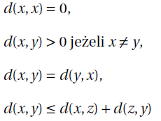
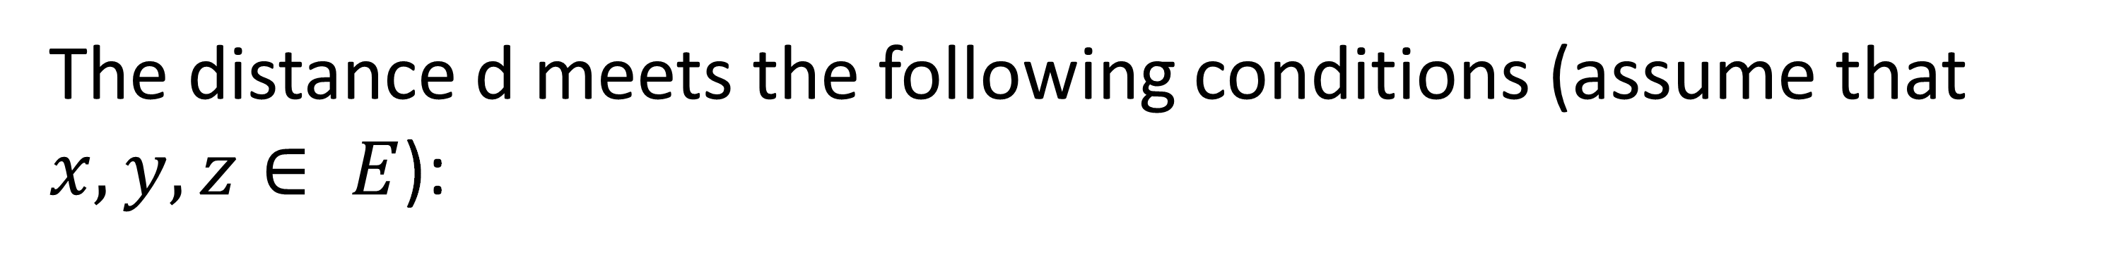
Distances
The distance d meets the following conditions (assume that $x,y,z∈ E$):
The most common example of distance is the Euclidean distance and, consequently, the Euclidean space.

Slide 6
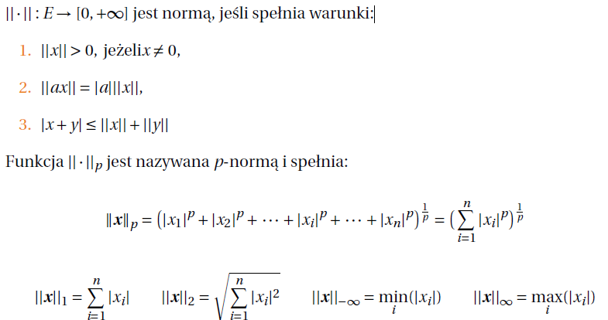
Norms
is a norm if it meets the conditions:
if
The function $||∙|{\left.​\right|}_{p}$is called p-norm and satisfies:

Slide 7

Distances
A normalized vector space is a metric space with distance:
$$d\left(x,y\right)=|\left|x−y\right||$$
If, in addition, this normalized vector space $E$ is complete,
it is called Banach’s space.

Slide 8
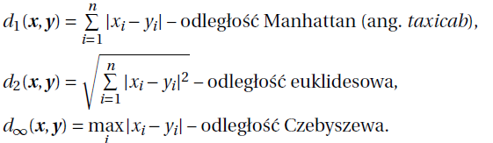

Normalized space
The introduction of the concept of p-norm was necessary due to the fact that p-norm influences form (p-norm distance):
$$d_{p}\left(x,y\right)=|\left|x−y\right||$$
Manhattan distance (taxicab)
Euclidean distance
Chebyshev distance

Slide 9
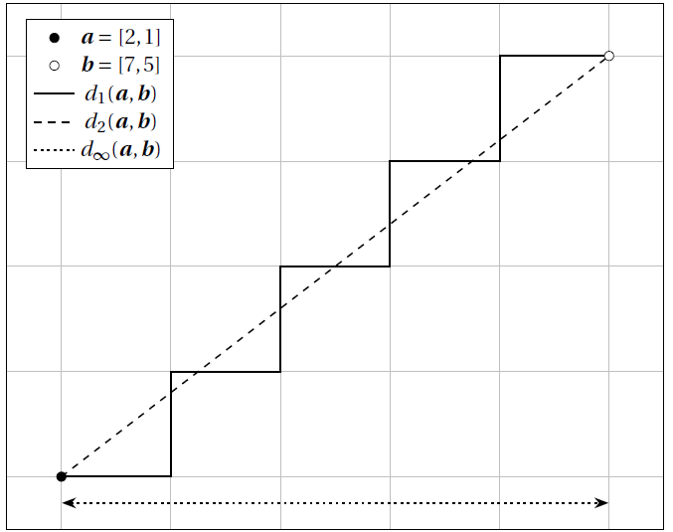
Distance based on p-norms

Slide 10


Approximation
The approximation problem is the approximation of the function f (x) in a given interval using another function P(x), usually simpler, usually from the classes of approximating functions.
If the function is given as a set $\left(x_{i},y_{i}\right){\left.​\right|}_{i=1 }^{n}$then we are dealing with an 'point’ approximation
If the function has the analytical form $y=f(x)$, we are dealing with an integral approximation
From the point of view of numerical analyzes in engineering issues, the first group is more practical in nature.

Slide 11
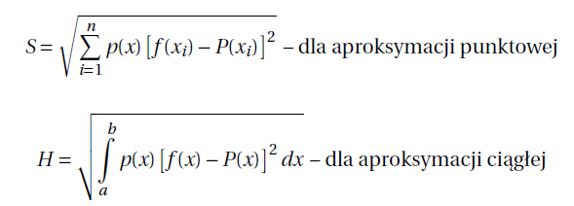
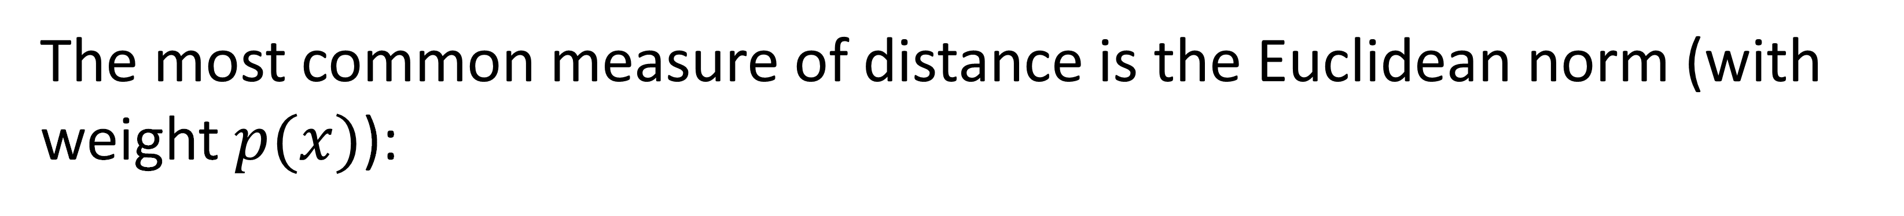
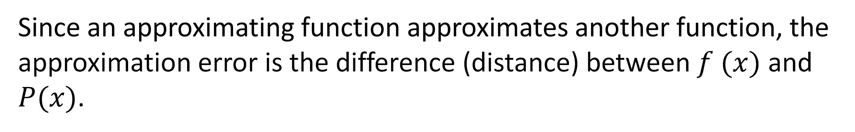
approximation quality
Since an approximating function approximates another function, the approximation error is the difference (distance) between $f (x)$ and $P(x)$.
The most common measure of distance is the Euclidean norm (with weight $p(x)$):
for point approximation
for continuous approximation

Slide 12
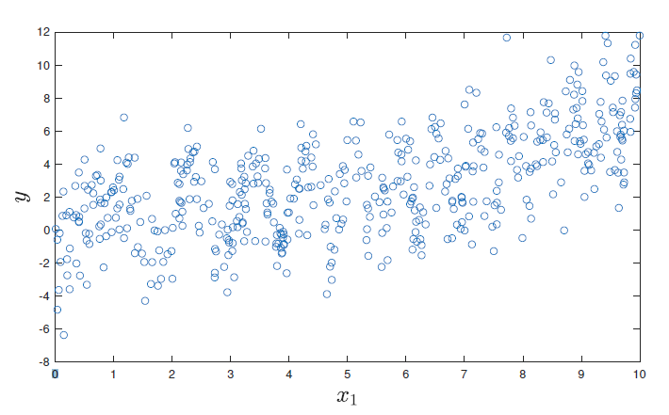
Approximation

Slide 13
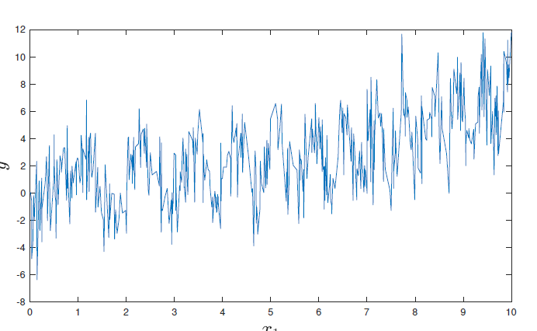
interpolation?

Slide 14
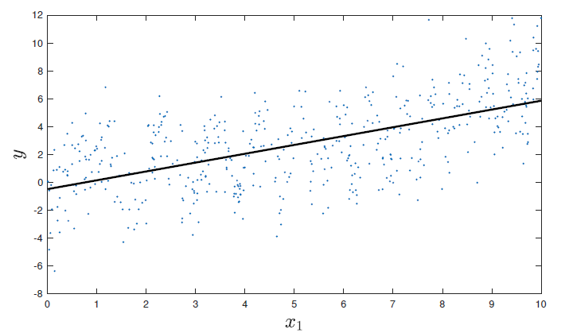
Approximation of a linear function

Slide 15
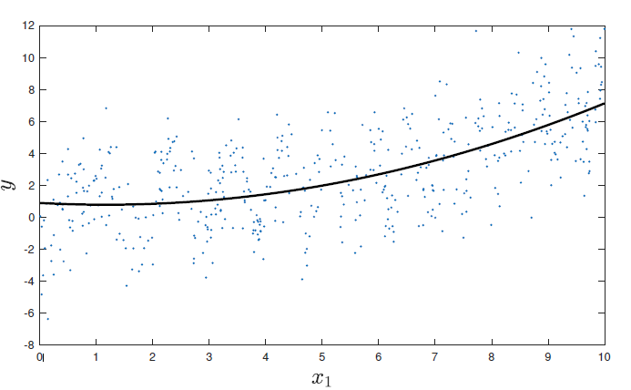
Approximation of the quadratic function

Slide 16
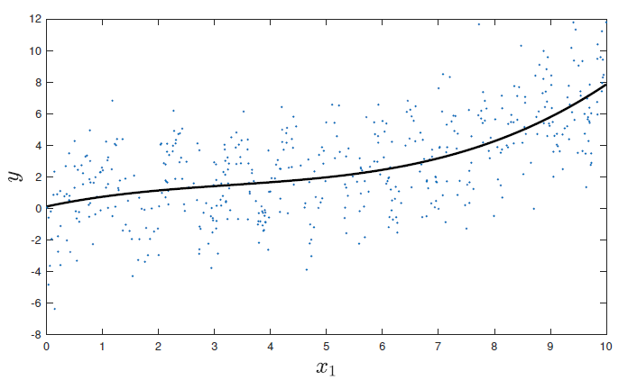
Approximation with a third degree polynomial

Slide 17
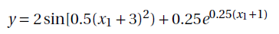
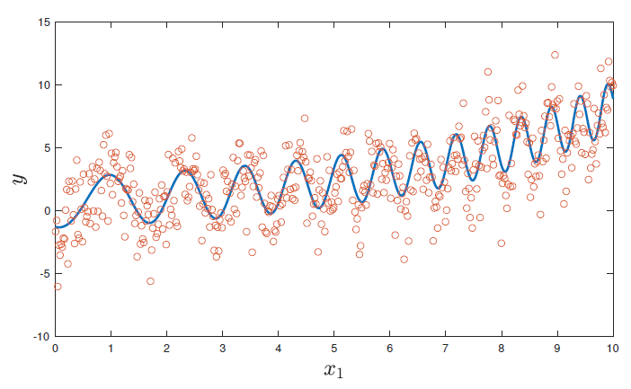
The function from which the points $(x_{i},y_{i})$truly come

Slide 18
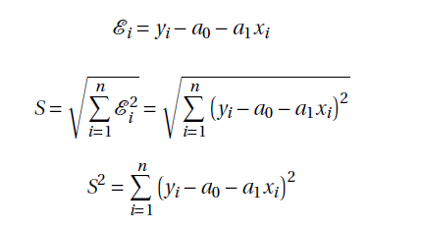

Linear approximation
Building a line approximating points $(xi,yi)$ is based on finding the coefficients $a_{0}$ and $a_{1}$, which minimize:
The above procedure is called the Least Squares Method

Slide 19
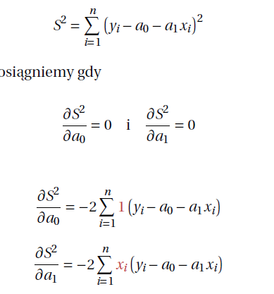
Polynomial approximation – least squares method
The minimum value of $S^{2}$ will be reached when

Slide 20
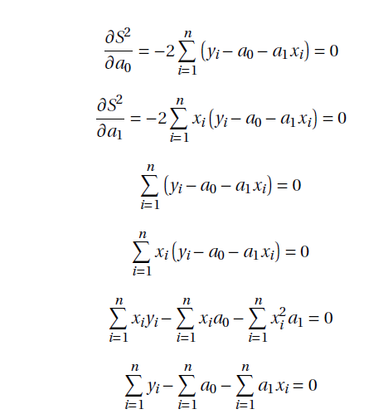
Polynomial approximation – least squares method

Slide 21
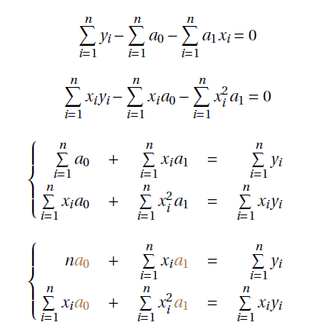
Polynomial approximation – least squares method

Slide 22
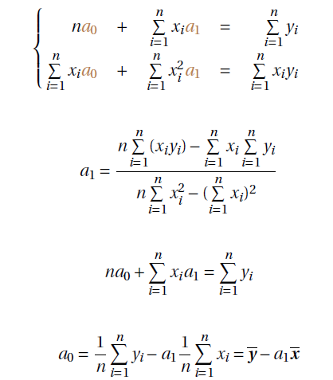
Polynomial approximation – least squares method

Slide 23
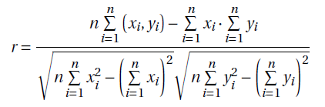
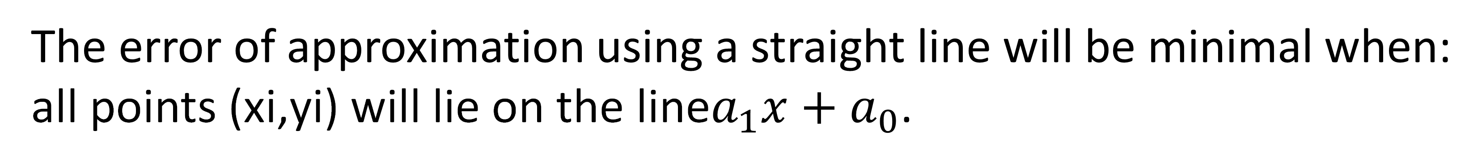
Error- least squares method
The error of approximation using a straight line will be minimal when:
all points (xi,yi) will lie on the line$a_{1}x+a_{0}$.
Therefore, the error of approximation using a straight line will be expressed by itself
The mutual position of the points is determined by the correlation coefficient r:

Slide 24
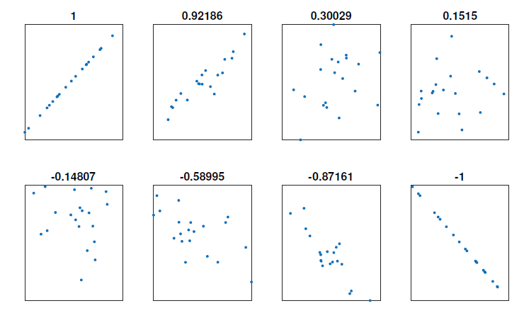
Correlation coefficient

Slide 25
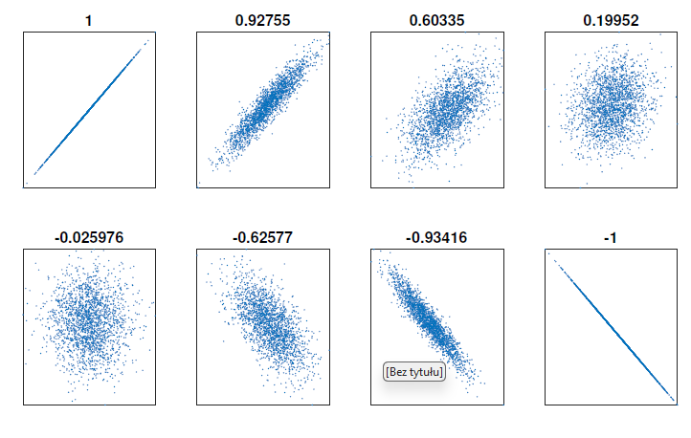
Correlation coefficient

Slide 26
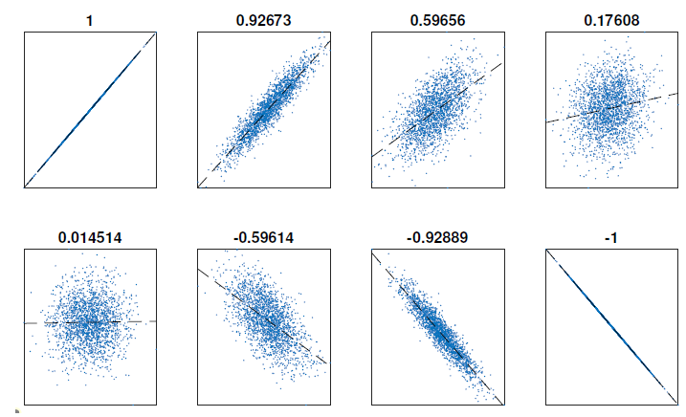
Correlation coefficient

Slide 27
Example – approximation with a first-1st polynomial
An experiment was carried out to assess the % elongation of an electrical conductor in temperature function.
measurement | 1 | 2 | 3 | 4 | 5 | 6 | 7
temperature | 200 | 250 | 300 | 375 | 425 | 475 | 600
Elongation % | 4,2 | 5,3 | 5,4 | 6,7 | 8 | 9,4 | 12

Slide 28
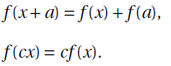
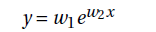
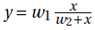
Linearization of non-linear dependencies
The linear approximation assumed a linear relationship $y=f\left(x\right)$i:
Data often does not show a linear relationship in engineering.
Often, these may be the following $x→y$ dependencies:
exponential
power
positive concave

Slide 29
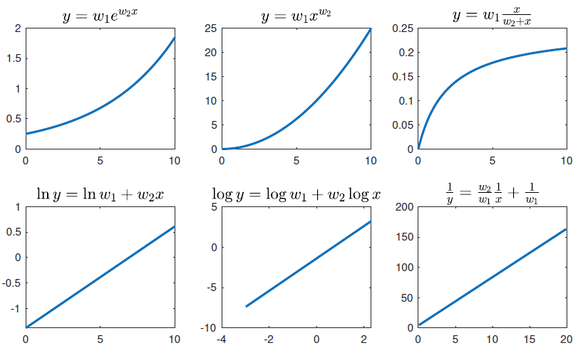
Linearization of non-linear dependencies

Slide 30
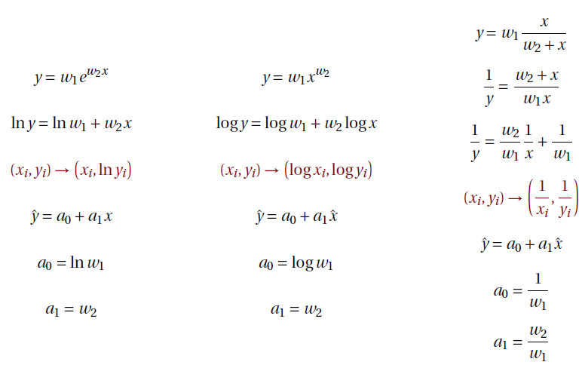























Linearization of non-linear dependencies

Slide 31
Linearization of non-linear dependencies
The table below contains records in runs in 2021(time in seconds):
Dist [m] | 100 | 200 | 400 | 800 | 1000 | 1500 | 2000 | 5000 | 10000 | 20000 | 42195
women | 10,49 | 21,34 | 47,60 | 113,28 | 148,98 | 230,07 | 321,56 | 846,62 | 1741,03 | 3601,11 | 8044,00
men | 9,58 | 19,19 | 43,03 | 100,91 | 131,96 | 206,00 | 284,79 | 755,36 | 1571,00 | 3380,02 | 7299,00
We will test the approximation approach using a linear function and build a power model.

Slide 32
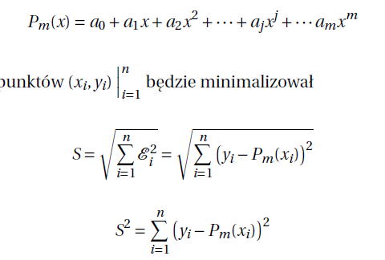
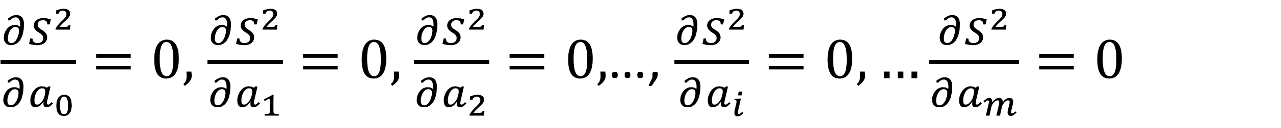





Polynomial approximation using the least squares method
The generalized least squares method is designed to find a polynomial
$m$th degree with the form:
which for the set of points=$\left(x_{i}y_{i}\right){\left.​\right|}_{i=1}^{n}$will minimize the following expression:
which for the set of points=$\left(x_{i}y_{i}\right){\left.​\right|}_{i=1}^{n}$will minimize the following expression:
$\frac{∂S^{2}}{∂a_{0}}=0,$ $\frac{∂S^{2}}{∂a_{1}}=0,$ $\frac{∂S^{2}}{∂a_{2}}=0,$…, $\frac{∂S^{2}}{∂a_{i}}=0,…\frac{∂S^{2}}{∂a_{m}}=0$

Slide 33
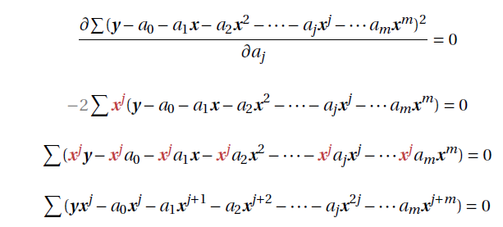

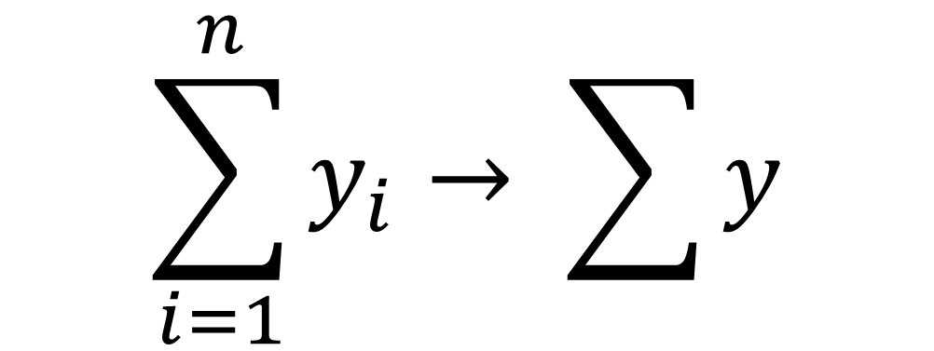
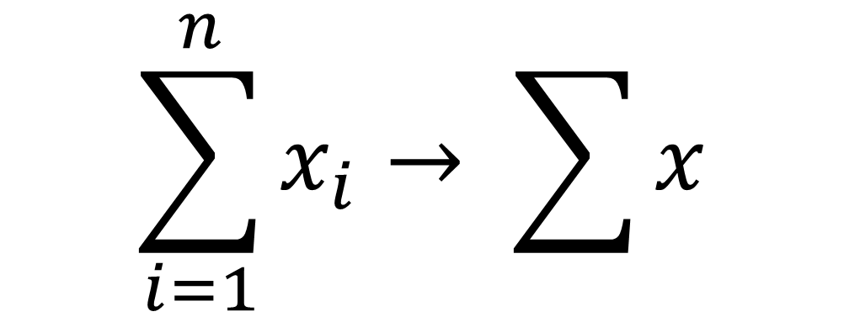
Polynomial approximation using the least squares method
$$\sum_{i=1}^{n}{x_{i}→ \sum{x}}$$
$$\sum_{i=1}^{n}{y_{i}→ \sum{y}}$$

Slide 34
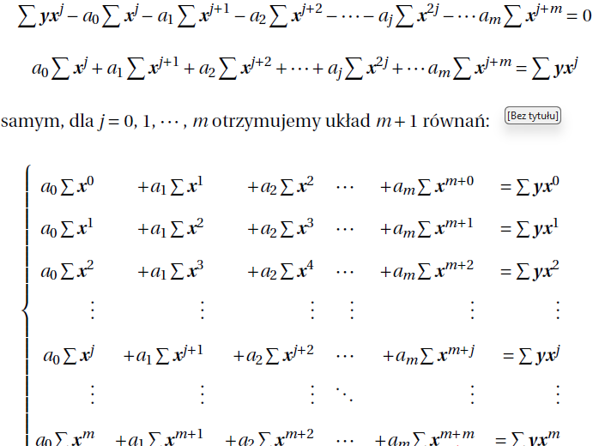



Polynomial approximation using the least squares method
Therefore, for $j=0,1,…,m$ we obtain the system $m+1$equals:

Slide 35
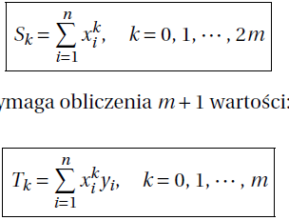



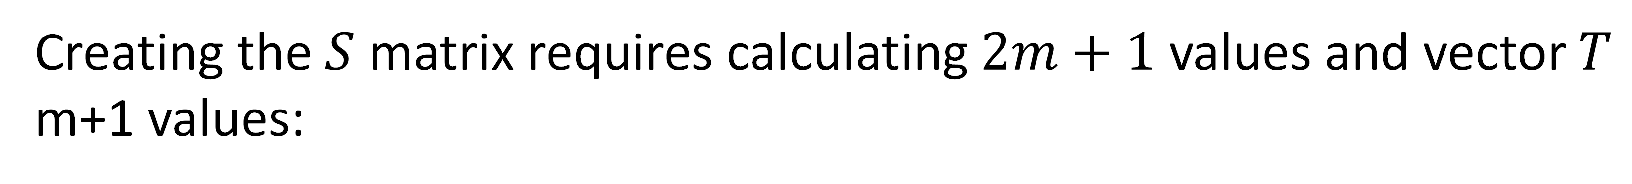





Polynomial approximation using the least squares method
The system of equations has $m$ unknowns ($a_{0}, .., a_{m}$).
Let us denote this system of equation as $Sa=T$
Creating the $S$ matrix requires calculating $2m+1$values and vector $T$ m+1 values:

Slide 36
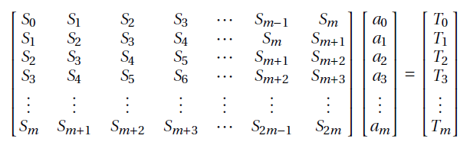
Polynomial approximation using the least squares method
This can be written as:

Slide 37
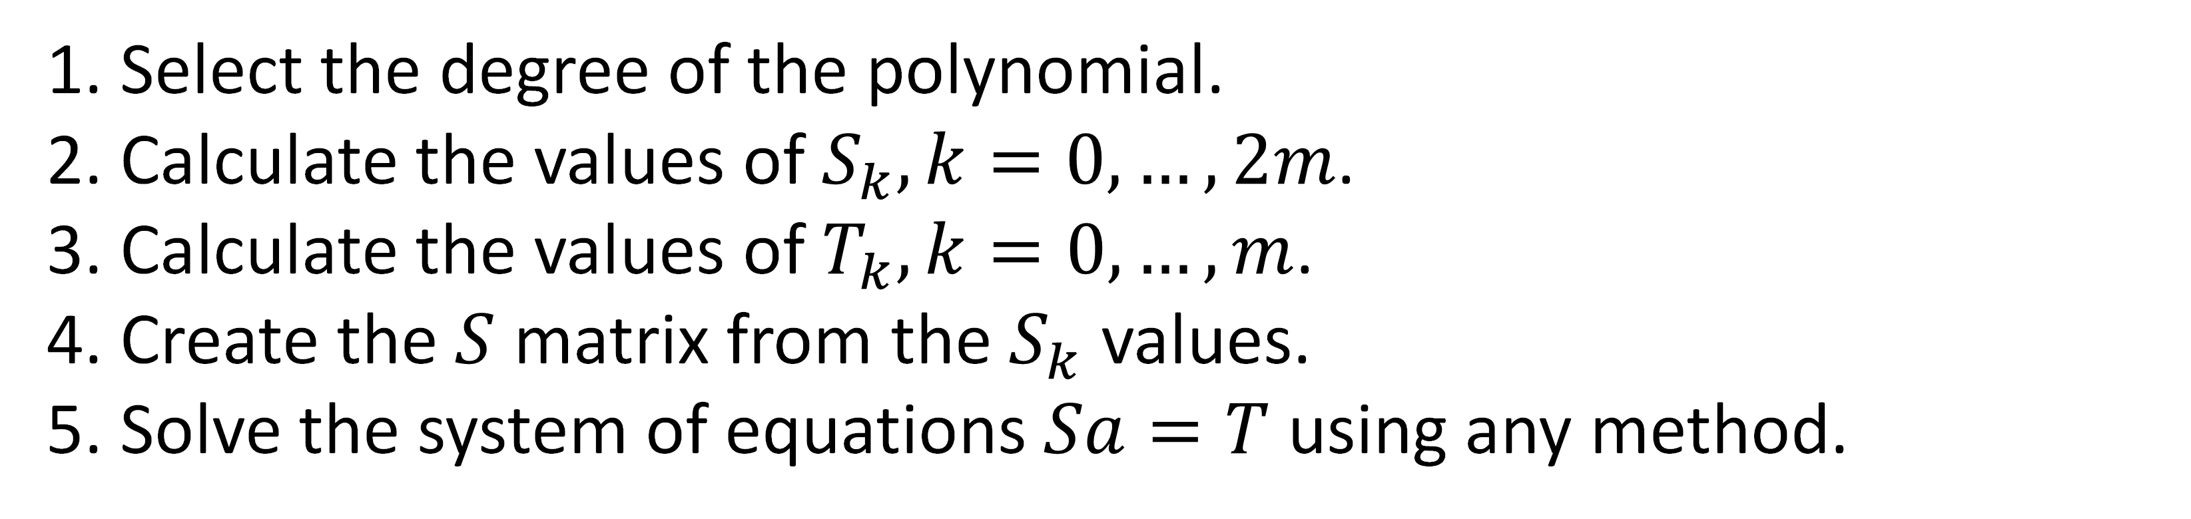
Polynomial approximation using the least squares method
Given a set of x and y with n elements in each of them, the order of execution the action is as follows:
1. Select the degree of the polynomial.
2. Calculate the values of $S_{k}, k=0,…, 2m$.
3. Calculate the values of $T_{k}, k=0,…,m$.
4. Create the $S$ matrix from the $S_{k}$ values.
5. Solve the system of equations $Sa=T$using any method.

Slide 39
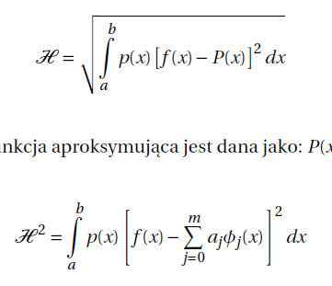
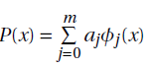
Function approximation
In the problem of continuous root mean square approximation, we deal with the following measure determining its quality:
This time, however, the approximating function is given as:

Slide 40
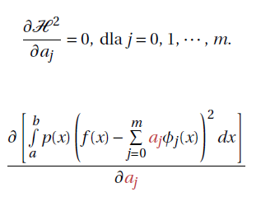
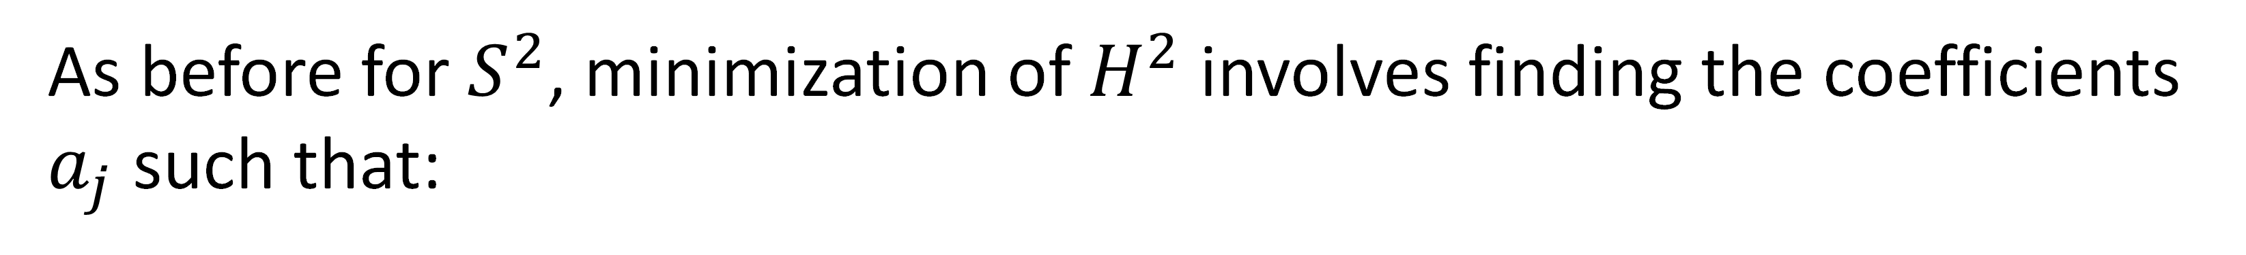
Function approximation
As before for $S^{2}$, minimization of $H^{2}$ involves finding the coefficients $a_{j}$ such that:
The values of $a_{j}$ are not functions of the variable x.

Slide 41
Function approximation
As before for $S^{2}$, minimization of $H^{2}$ involves finding the coefficients $a_{j}$ such that:
The values of $a_{j}$ are not functions of the variable x.

Slide 42
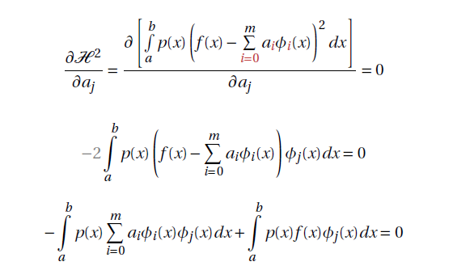

Function approximation
Due to the fact that all coefficients $a_{j}$ appear in $H^{2}$, the notation in the polynomial $P(x)$ should be changed:

Slide 43
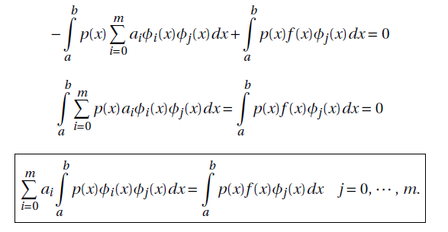
Function approximation
The ease of determining $a_{j}$ depends on the choice of basis functions $φ_{j}(x)$.

Slide 44
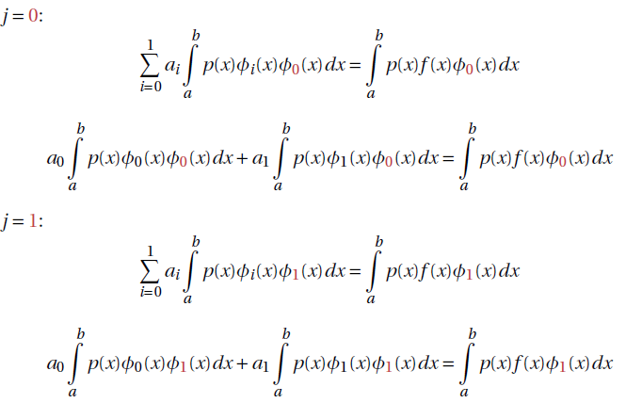
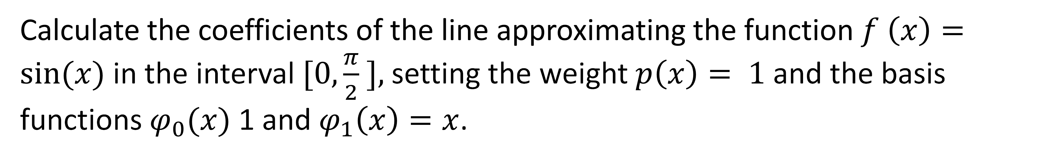
Continuous mean square approximation – example
Calculate the coefficients of the line approximating the function$f \left(x\right)=sin⁡(x)$in the interval $[0,\frac{π}{2} ],$setting the weight $p\left(x\right)= 1$ and the basis functions $φ_{0}(x)$1 and $φ_{1}\left(x\right)=x$.

Slide 45
Continuous mean square approximation – example
Calculate the coefficients of the line approximating the function$f \left(x\right)=sin⁡(x)$in the interval $[0,\frac{π}{2} ],$setting the weight $p\left(x\right)= 1$ and the basis functions $φ_{0}(x)$1 and $φ_{1}\left(x\right)=x$.

Slide 46
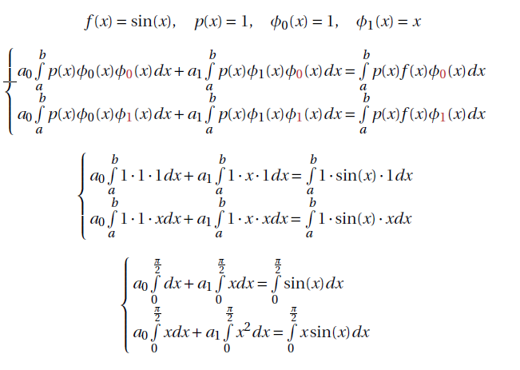
Continuous mean square approximation – example

Slide 47
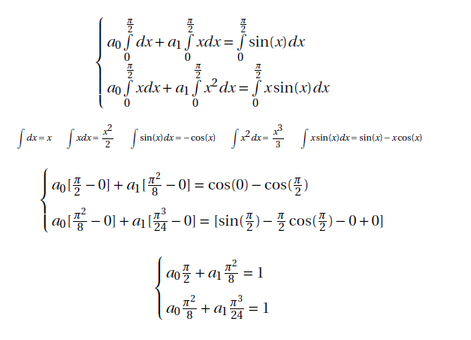
Continuous mean square approximation – example

Slide 48


Continuous mean square approximation – example
We can obtain the same approximation by generating the appropriate number of points for the function $f (x)$ in this interval and finding $P(x)$ using the least squares method.

Slide 49


Continuous mean square approximation
mth degree requires calculation:
• $2m+1$ integrals from products of basis functions $φ_{i}(x) φ_{j}(x)$,
• $m+1$ integrals from the product of the base and approximate functions${f(x)φ}_{j}(x)$
You can simplify this process and use the so-called polynomials
orthogonal.

Slide 50


Orthogonal and orthonormal system
The symbol (f ,g) is called the inner product.
• (f ,g) in continuous space is the integral of the product of f (x) and g(x).
• (f ,g) in discrete space is the sum of the products of the elements of vectors f and g.
Calculating norm $\left|\left|f\right|\right|$and $\left|\left|g\right|\right|$will give the value 1 in both cases, just $f^{T} f$ or $g^{T}g$gave a result of 1.

Slide 51







Orthogonal and orthonormal system
from Greek: orthos – straight, gonia – angle

Slide 52

Orthogonal and orthonormal system
Using orthogonal polynomials w
on the left side, every product except the case $i=j$will be equal to 0.
Thus, each equation in the system of equations $j=0,…$m will simplify to

Slide 53



Orthogonal and orthonormal system
Thus, Calculating the Coefficients of the Approximating Polynomial
The above are orthogonal coefficients or Fourier coefficients.

Slide 54


Orthogonal polynomials – example
Let's check whether the set $\left\{\cos\left(kx\right)\right\}{\left.​\right|}_{k=0}^{n}$ is orthogonal (assuming the interval orthogonalities$from −π$to$π$:

Slide 55

Orthogonal polynomials – example
Let's check whether the set $\left\{\cos\left(kx\right)\right\}{\left.​\right|}_{k=0}^{n}$ is orthogonal (assuming the interval orthogonalities$from −π$to$π$:
All of the above are orthonormal systems (with weight $p(x)=1$)

Slide 56



Czebyszev polynomials
weight $p(x)=$

Slide 57



Legendre polynomials

Slide 58

Legendre polynomials
Defined for an interval $x∈\left[0, \backslash inf \right]$ with weight $e^{−x}$

Slide 59

Hermitte polynomials
Defined for an interval $x∈\left[−\backslash inf , \backslash inf \right]$ with weight $e^{−x^{2}}$

Slide 60
Hermitte polynomials
Defined for an interval $x∈\left[−\backslash inf , \backslash inf \right]$ with weight $e^{−x^{2}}$

